Slide 1
What does Agile mean?
Andreas Odermatt
2016
https://github.com/odaner/whatDoesAgileMean

Slide 2
This talk is highly inspired by Dave Thomas, Martin Fowler, Neal Ford and Dan North
thanks
<3

Slide 3
We need to separate the implementation of something from the specification of something.
And we all know how hard that is.

Slide 4
1999
How was the world developing software back then?
99% of all software projects were like this

Slide 5
But there where also many new ideas.
all of them were focused on
„how can we cut down all of that bullshit
and just focus on writing software!“

Slide 6
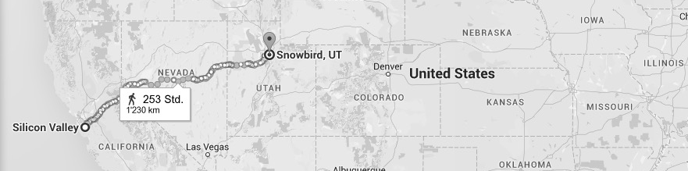
Angry
Engineers
New
Ideas
OOPSLA
Con

Slide 7
After less than 1 day, they came up with
a short list of values
Individuals and Interactions over Processes and Tools Working Software over Comprehensive Documentation Customer Collaboration over Contract Negotiation, and Responding to Change over Following a Plan

Slide 8
There was extra time left.
They did what developers do.
They filled in the time with some random stuff.
Principles

Slide 9
Principles
Our highest priority is to satisfy the customer through early and continuous delivery of valuable software
Business people and developers must work together daily throughout the project.
Welcome changing requirements, even late in development. Agile processes harness change for the customer's competitive advantage.
The best architectures, requirements, and designs emerge from self-organizing teams.
Build projects around motivated individuals. Give them the environment and support they need, and trust them to get the job done.
Deliver working software frequently, from a couple of weeks to a couple of months, with a preference to the shorter timescale.

Slide 10
They just published their stuff on the web.
the
Manifesto for Agile Software Development
was born

Slide 11
And that was it.
And that was probably a mistake.

Slide 12
What has happened since?
The root of all the evil

Slide 13
The root of all the evil
(that’s where the developers take a large part of the blame)
Developers ❤️ new, bright & shiny things
Agile was the cool new thing out there.
What, you aren’t doing Agile?

Slide 14
The root of all the evil - Nr. 2
The Manifesto tells you WHY to develop agile. But not HOW.

Slide 15
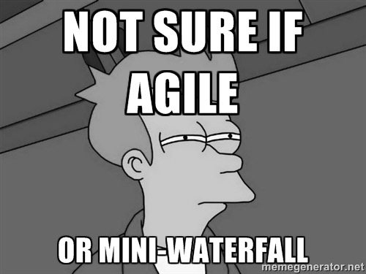
People get nervous.
(particularly management)
We want to be cool too, but:
This is strange!
How do we use this?
Are we doing it right?

Slide 16

Fear sells.
New roles
New words
New ways to plan
New ways to measure
New ways to manage and lead

Slide 17
Let’s summarize
We have a popular, cool new movement
There are many proofs that “it” really works
Great software has been built
Teams and customers are happier than before
This leads to
Many people want to do ”it” but don’t know how
The “it” is not yet defined
There’s no copyright or trademark

Slide 18
That’s an opportunity to sell stuff!
We teach you HOW to do “it” right
Books
Trainings
Conferences
Consultancy
But what’s “it”?

Slide 19
Evil Nr. 3 – The „it“
Manifesto for Agile Software Development
people call it
Agile Manifesto

Slide 20
agile is an adjective.
Hi, I’m the
agile Manifesto

Slide 21
Adjectives don’t sell.
Nouns sell.
So, they converted agile into a noun.
Agile Alliance
How to do Agile
Agile for Dummies
Scaling Agile
Agile this, Agile that…

Slide 22
They succeeded.
Agile became
a marketing term.

Slide 23
Agile is the brand
What is the product it sells?

Slide 24
Scrum
Kanban
SAFe
TDD
GitFlow
Pull Request
Jira
Wiki
CI
Docker
Jenkins
Slack

Slide 25
Remember the first value of the Manifesto?
„Individuals and Interactions over Processes and Tools“
google it:
„Agile Process“ +50’000'000
„Agile Tools“ +45’000'000

Slide 26
The Agile product.
buy tools.
adapt processes.
BE FASTER.

Slide 27
What’s next?

Slide 28
Every industry wants to grow.
The agile practices like XP and Scrum
were designed for small teams.
But the money is in the big companies.
Let’s scale it!

Slide 29
You need an Agile Organization
Agile Management (3.0)
Agile Requirements Engineering
Agile Testing
Agile Architecture
Agile Integration and Delivery

Slide 30
When faith becomes religion
Processes and Tools over Individuals and Interactions Comprehensive Documentation over Working Software
Contract Negotiation over Customer Collaboration, and Following a Plan over Responding to Change

Slide 31
Agile has become an industry.
The values and principles
have been totally lost.
A word that is abused in
this way becomes useless.
It stops having meaning
as it transitions into a brand.
Dave Thomas

Slide 32
Play the game? Back to waterfall? (whaaaaat!!??)
What to do?

Slide 33
Back to the basics
Individuals and Interactions over Processes and Tools Working Software over Comprehensive Documentation Customer Collaboration over Contract Negotiation, and Responding to Change over Following a Plan

Slide 35
It’s time to reclaim Agility!
Because we all still belive in the
Values of Agility
but faith should not become religion

Slide 36
Agility
3 Steps + 1 Loop
What to do
Find out where you are
Take a small step towards your goal
Adjust your understanding based on what you learned
⟳ Repeat
How to do it
When faced with two or more alternatives that deliver roughly the same value, take the path that makes future change easier.

Slide 37
It‘s time to kill Agile
But we should not stop
doing things agile.

Slide 38
We’ve lost the word agile. Let’s try to hang on to agility. Let’s keep it meaningful, and let’s protect it from those who would take the soul of our ideas in order to sell it back to us.
Dave Thomas

Slide 39
Google results for ”Agility”

Slide 40
Sources
http://agilemanifesto.org
http://pragdave.me/blog/2014/03/04/time-to-kill-agile/
https://youtu.be/a-BOSpxYJ9M
https://youtu.be/GE6lbPLEAzc
https://vimeo.com/44234746
https://www.artefactgroup.com/content/post-agile-a-design-thinking-approach-to-software-development/
https://github.com/oreillymedia/97-things-every-agile-developer-should-know/blob/master/Beware_Of_Agile_Zealots.asciidoc

Slide 41
Agile is dead
Long Live Agility!

